Slide 1
NCA Sponsored Training
Day 3 – Afternoon Session (Lab)
Network Security 2
Presenter Name
City
February 2024
Notes:
Some of the material used in this presentation has been adapted and remixed from course materials from the Virginia Tech University and Purdue University

Slide 2
Outline
DNS utilities
Host
Dig
Fingerprinting/scanning
nmap

Slide 3
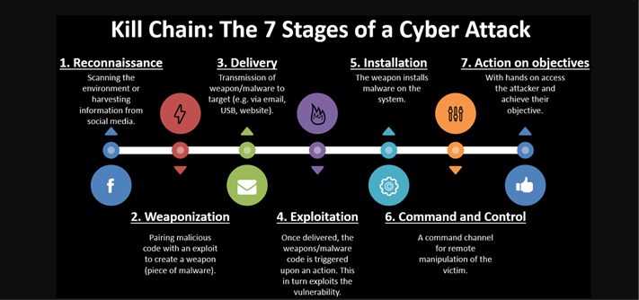
Lab on Reconnaissance (fingerprinting/scanning)
Reconnaissance (fingerprinting/scanning): First phase of kill chain cyberattack model. It helps the attacker understand the environment around the victim: target addresses, network, architecture, devices, etc.

Slide 4
Host
What is host utility?
command used for DNS (Domain Name System) lookup operations, e.g.,:
find the IP address of a particular domain name or
find out the domain name of a particular IP address or
much more DNS configuration details

Slide 5
Host
host [-t type] hostname [server]
Operation | Command | Example
lookups – mapping names to addresses | host HOST | host google.com
Reverse lookups – mapping addresses to names | host IP_ADDRESS | host 192.168.0.10
lookups at DNS Server | host HOST SERVER | host google.com 8.8.8.8
lookups at DNS Server | host IP SERVER | host 74.125.235.101 8.8.8.8
lookup for an any record | host -t any HOST | host -t any google.com
lookup for an soa record | host -t soa HOST | host -t soa google.com
lookup for an ns record | host -t ns HOST | host -t ns google.com
lookup for an a record | host -t a HOST | host -t a google.com
lookup for an mx record | host -t mx HOST | host -t mx google.com
lookup for an txt record | host -t txt HOST | host -t txt google.com
lookup for an any record -a is equivalent to -v -t ANY | host -a HOST | host -a google.com
Notes:
https://cmdref.net/os/linux/command/host.html
https://www.geeksforgeeks.org/host-command-in-linux-with-examples/

Slide 6
Dig deeper
What is dig utility:
command used to dig deeper in DNS (Domain Name System) lookup operations, e.g.,:
find the IP address of a particular domain name or
find out the domain name of a particular IP address or
much more DNS configuration details

Slide 7
Dig deeper
dig [@global-server] [domain] [q-type]
Operation | Command | Example
lookups – mapping names to addresses | dig -x HOST | dig google.com
Reverse lookups – mapping addresses to names | dig -x IP_ADDRESS | dig -x 192.168.0.10
lookups at DNS Server | dig @SERVER HOST | dig @8.8.8.8 google.com
lookups at DNS Server | dig @SERVER -x IP | dig @8.8.8.8 -x 74.125.235.101
lookup for an any record (TXT, MX, SOA, A, NS) | dig HOST any | dig google.com any
lookup for an soa record | dig HOST soa | dig google.com soa
lookup for an ns record | dig HOST ns | dig google.com ns
lookup for an a record | dig HOST a | dig google.com a
lookup for an mx record | dig HOST mx | dig google.com mx
lookup for an txt record | dig HOST txt | dig google.com txt
lookup with trace | dig +trace HOST | dig +trace google.com
Notes:
https://cmdref.net/os/linux/command/dig.html
Display Is as follows
The HEADER section shows the information it received from the server. Flags refer to the answer format.
The OPT PSEUDOSECTION displays advanced data:
EDNS – Extension system for DNS, if used
Flags – blank because no flags were specified
UDP – UDP packet size
The QUESTION section displays the query data that was sent:
First column is the domain name queried
Second column is the type (IN = Internet) of query
Third column specifies the record (A = Address), unless otherwise specified
The STATISTICS section shows metadata about the query:
Query time – The amount of time it took for a response
SERVER – The IP address and port of the responding DNS server. You may notice a loopback address in this line – this refers to a local setting that translates DNS addresses
WHEN – Timestamp when the command was run
MSG SIZE rcvd – The size of the reply from the DNS server
https://phoenixnap.com/kb/linux-dig-command-examples

Slide 8
Nmap
What is nmap utility?
command (Network Mapper) network detection and security scanning utility,:
Host discovery (reachable target) with some Ips on the network/Internet
Scan open/closed ports of a host
Stealthy scans
Service version, OS detection
..
Notes:
https://nmap.org/book/man-host-discovery.html

Slide 9
Nmap - Target specification
nmap [scan types] [options] [server]
Change IP to target Metasploitable machine as a server
Option | Example | Description
 | nmap 192.168.1.3 | Scan a specific IP address
 | nmap 192.168.1.2 192.168.2.3 | Scan specific IP addresses
 | nmap 192.168.1.7-254 | Scan specific range of IP addresses
 | nmap example.com | Scans a domain
-iL | nmap -iL text.txt | Scans a target from a file
-iR | nmap -iR 200 | Scans random 200 hosts
–exclude | nmap -exclude 192.168.1.2 | Exclude the listed hosts
Notes:
Quick https://www.interviewbit.com/nmap-cheat-sheet/
Detailed https://nmap.org/book/man-target-specification.html

Slide 10
Set your Firewall
To observe the differences in the following commands, we will use Metasploitable Firewall
Go to Metasploitable VM. Our Firewall is UFW, on the terminal check it man UFW
Run as root (sudo su) and enable Firewall ufw enable
Go back to KALI and scan some ports (ftp, telnet, ssh) to make sure they are open/close. You can also run telnet 192.168.1.2 or ftp ftp 192.168.1.2
If they are open, it means they are not blocked ports, let’s block some ports!
Go to Metasploitable and block ftp port (21) ufw deny ftp (or even block all ports ufw default deny )
Check status ufw and notice the blocked port in Metasploitable
Back to KALI to scan and observe the difference
Enable port again and recheck: ufw delete deny ftp or ufw allow ftp
Notes:
Quick https://www.interviewbit.com/nmap-cheat-sheet/
Detailed https://nmap.org/book/man-host-discovery.html

Slide 11
Nmap – Host Discovery
On KALI machine, try these commands against Metasploitable IP and observe the output
Option | Example |  | Description
-sL | nmap 192.168.1.6-9 -sL |  | Creates targets List only
-sn | nmap 192.168.1.2/29 -sn |  | This disables port scans and does host discovery only.
-Pn | nmap 192.168.1.2-5 -Pn |  | This disables host discovery and allows port scan only.
-PS | nmap 192.168.1.2-5 -PS22-25,80 | TCP SYN | TCP SYN ping on port x.
-PA | nmap 192.168.1.2-5 -PA22-25,80 | TCP ACK | TCP ACK ping on port x.
-PU | nmap 192.168.1.3-7 -PU53 | UDP | Enables UDP ping on port x.
-PR | nmap 192.168.1.2-3/24 -PR | ARP | ARP ping on the local network
-n | nmap 192.168.1.2 -n | DNS | Disables DNS resolution
Notes:
Quick https://www.interviewbit.com/nmap-cheat-sheet/
Detailed https://nmap.org/book/man-host-discovery.html

Slide 12
Nmap – Stealthy Scan
Option | Example | Description
-sT | nmap 192.168.1.1 -sT | TCP Connect Scan | TCP full handshake connection (not stealthy)
-sS | nmap 192.167.1.2 -sS | TCP SYN Scan | Send SYN. Half-open connection. Bypass Firewall
-sU | nmap 192.168.1.1 -sU | UDP scan | no response means open port
-sA | nmap 192.168.1.1 -sA | TCP ACK Scan | Send ACK. No response means filtered port (Firewall)
-sW | nmap 192.168.1.1 -sX | TCP Xmas scan | Set FIN/URG/PUSH flags. No response means open/filtered
-sM | nmap 192.168.1.1 -sM | TCP Maimon scan | Set FIN/ACK flags. No response means open/filtered port
Notes:
Quick https://www.interviewbit.com/nmap-cheat-sheet/
Detailed https://nmap.org/book/man-port-scanning-techniques.html

Slide 13
Nmap – Port Specification
Option | Example | Description
-p | nmap 192.168.1.9 -p 27 | Scan a specific port
-p | nmap 192.168.1.9 -p 27-100 | Scan a port range
-p | nmap 192.168.1.9 -p U:53,T:27-40,80 | Scans multiple TCP and UDP ports
-p- | nmap 192.168.1.9 -p- | Scan all ports
-p | nmap 192.168.1.9 -p http,https | Scans based on the service name
-F | nmap 192.168.1.9 -F | Scan 100 ports in fast manner
–top-ports | nmap 192.168.1.9 -top-ports 1015 | Scans the top “x” ports
Notes:
Quick https://www.interviewbit.com/nmap-cheat-sheet/
Detailed https://nmap.org/book/man-host-discovery.html

Slide 14
Nmap – Port Specification
Other utilities
whois
Traceroute
Nslookup

Slide 15
Backlog

Slide 16
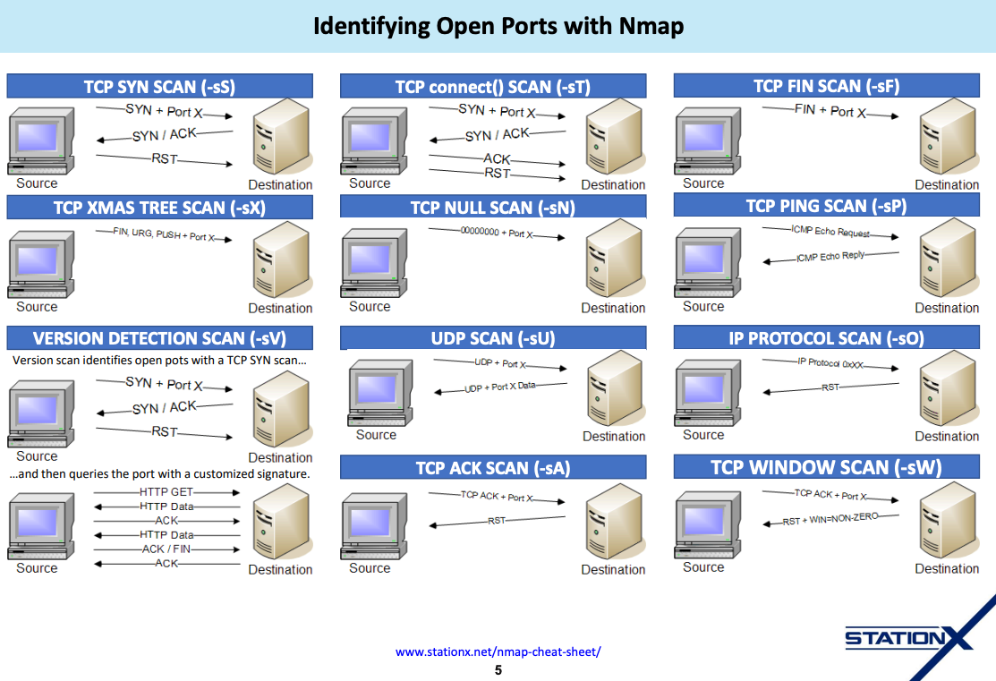
Nmap visuals
Notes:
https://stationx-public-download.s3.us-west-2.amazonaws.com/nmap_cheet_sheet_v7.pdf

Slide 17

Do you have any questions?

